Slide 1
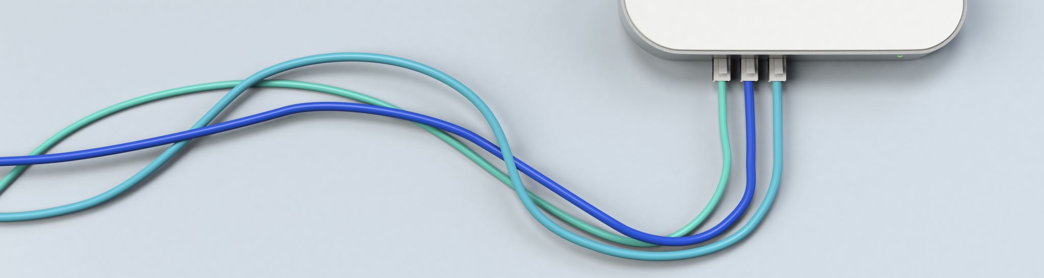
Cloud Computing

Slide 2
Definition
Cloud computing is the on-demand delivery of IT resources over the Internet with pay-as-you-go pricing. Instead of buying, owning, and maintaining physical data centers and servers, you can access technology services, such as computing power, storage, and databases, on an as-needed basis from a cloud provider like Amazon Web Services (AWS),Microsoft Azure and many more

Slide 3
Data Center
A data center is a facility that centralizes an organization's shared IT operations and equipment for the purposes of storing, processing, and disseminating data and applications. Because they house an organization's most critical and proprietary assets, data centers are vital to the continuity of daily operations.
1)On-Premise
2)Cloud
3)Hybrid

Slide 4
Defining IaaS, PaaS, and SaaS
Infrastructure as a service (IaaS)
A vendor provides clients pay-as-you-go access to storage, networking, servers, and other computing resources in the cloud.
Platform as a service (PaaS)
A service provider offers access to a cloud-based environment in which users can build and deliver applications. The provider supplies underlying infrastructure.
Software as a service (SaaS)
A service provider delivers software and applications through the internet. Users subscribe to the software and access it via the web or vendor APIs.

Slide 5
7 Most Common Cloud Computing Challenges
1. Data Security and Privacy
2. Cost Management
3. Multi-Cloud Environments
4. Performance Challenges
5. Interoperability and Flexibility
6. High Dependence on Network
7. Lack of Knowledge and Expertise

Slide 6
Pricing
https://aws.amazon.com/free/?all-free-tier.sort-by=item.additionalFields.SortRank&all-free-tier.sort-order=asc&awsf.Free%20Tier%20Types=*all&awsf.Free%20Tier%20Categories=categories%23storage&trk=cd37b959-f703-4430-b8e1-8abc8d8a9469&sc_channel=ps&sc_campaign=acquisition&sc_medium=ACQ-P|PS-GO|Non-Brand|Desktop|SU|Storage|Solution|IN|EN|Text&s_kwcid=AL!4422!3!536394092773!e!!g!!cloud%20storage%20pricing&ef_id=EAIaIQobChMIz5ThjICM9wIVCg4rCh2kjAXDEAAYBCAAEgICN_D_BwE:G:s&s_kwcid=AL!4422!3!536394092773!e!!g!!cloud%20storage%20pricing

Slide 7
Platform Overview
Amazon
https://aws.amazon.com/pm/ec2-amd/?trk=17a47518-9bfe-4f1e-a67f-42bdd19264e5&sc_channel=ps&sc_campaign=acquisition&sc_medium=ACQ-P|PS-GO|Brand|Desktop|SU|Compute|EC2%20AMD|IN|EN|Text&s_kwcid=AL!4422!3!525855180419!p!!g!!amazon%20web%20server&ef_id=EAIaIQobChMIu9Wnz4CM9wIV7ZNmAh3KMgDxEAAYASAAEgKSnfD_BwE:G:s&s_kwcid=AL!4422!3!525855180419!p!!g!!amazon%20web%20server

Slide 8
Platform Overview
Microsoft Azure
https://azure.microsoft.com/en-in/overview/what-is-azure/?&ef_id=EAIaIQobChMIhZGIgIGM9wIVd51LBR3GZwn_EAAYASAAEgKSJ_D_BwE:G:s&OCID=AID2200195_SEM_EAIaIQobChMIhZGIgIGM9wIVd51LBR3GZwn_EAAYASAAEgKSJ_D_BwE:G:s&gclid=EAIaIQobChMIhZGIgIGM9wIVd51LBR3GZwn_EAAYASAAEgKSJ_D_BwE

Slide 9
Platform Overview
Google Cloud
https://cloud.google.com/gcp/?utm_source=google&utm_medium=cpc&utm_campaign=japac-IN-all-en-dr-skws-all-all-trial-b-dr-1009882&utm_content=text-ad-none-none-DEV_c-CRE_560258474584-ADGP_Hybrid%20%7C%20SKWS%20-%20PHR%20%7C%20Txt%20~%20GCP%20~%20General_general-KWID_43700065766031221-aud-1596662390094%3Akwd-12355516129&userloc_1007768-network_g&utm_term=KW_cloud%20platforms&gclid=EAIaIQobChMItNqBnIGM9wIVAUwrCh1Q-AKvEAAYASAAEgKGUPD_BwE&gclsrc=aw.ds

